Slide 1



DEPI
Company
CAR
SALES PREDCTION
24 Oct, 2024

Slide 2
TEAM LEADER:
Name : ayyad yasser fathy
email : ayadsroor7@gmail.com
MEMBERS:
Name: Walaa Adel Abdelaleem
email:walaaadel2021@gmail.com
Name : Mahmoud samy elwahsh
email : Mahmoudelwahsh48@gmail.com
Name:Maha Esam Abdelrahman
email : maha.esam88112@gmail.com

Slide 3

Agenda
01
Introduction
05
Final Insights and Business Recommendations
02
Data Collection and Exploration
06
Model Development and Price Prediction
03
Data Cleaning and Preprocessing
07
Model Tuning and Optimization
04
08
Data Analysis and Visualization
Deployment by Streamlit & git hub

Slide 4

As a data scientist, our goal is to derive valuable insights from data to guide strategic decisions. In this project, we focus on predicting car prices using traditional machine learning models such as Random Forest, XGBRegressor, Linear Regression, and Decision Tree. These models allow us to identify key factors influencing car prices and deliver accurate predictions.
Introduction
DEPI Company

Slide 5
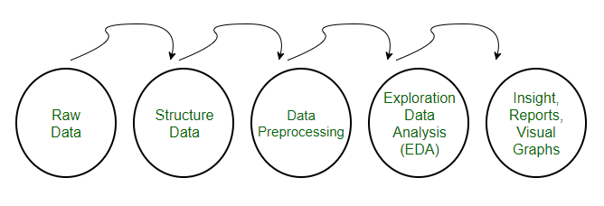
Data
preprocessing steps

Slide 6

Data Collection
and Exploration
link of dataset :
https://www.kaggle.com/datasets/missionjee/car-sales-report/data
Description:
The dataset used in this project contains various features related to car sales, which are critical for understanding market trends and predicting car prices.

Slide 7
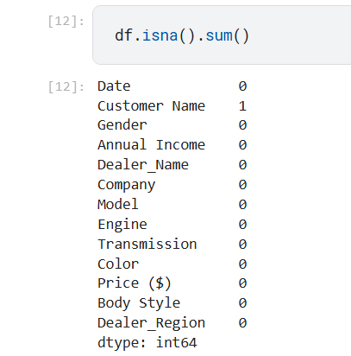
Handling Missing Data :
Missing values can be handled by removing rows/columns with missing data or imputing them using techniques like mean, median, mode , or by building a clutstring or classification model
example :
Data Cleaning

Slide 8
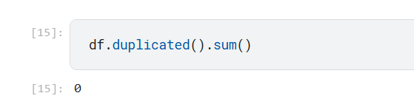
Remove Duplicates
Identify and remove duplicate rows to prevent redundancy and bias in the dataset.
example :
Data Cleaning

Slide 9
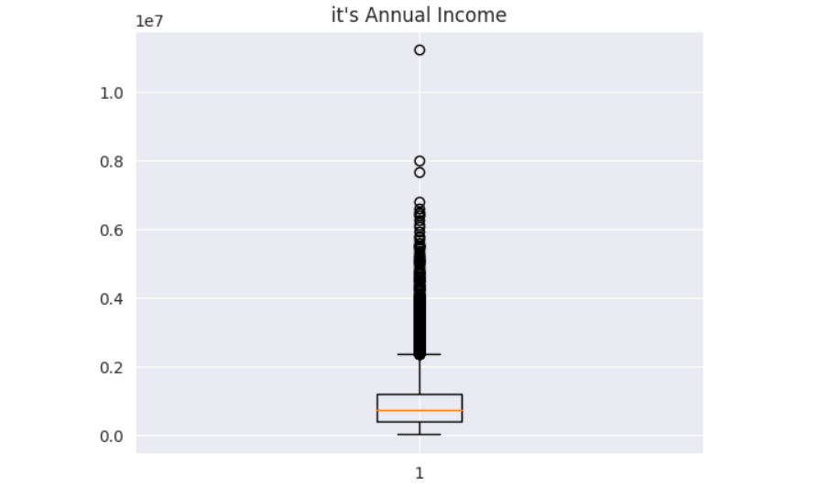
Outlier Detection and Treatment :
Identifying and handling outliers (extreme values) through methods like IQR, to prevent them from distorting model predictions.
example :
Data Cleaning

Slide 10
Fix Inconsistent Data:
Standardize inconsistent formats, such as inconsistent capitalization, incorrect date formats, or inconsistent categories
Convert Data Types:
feature engineering:
Ensure data types are correctly assigned (e.g., convert strings to datetime objects, numerical data from strings).
Correct Invalid Values:
Detect and correct invalid or erroneous data entries (e.g., negative ages or impossible values)

Slide 11

Data Analysis and Visualization
In this phase of the project, we explored relationships between key variables in the dataset to uncover valuable insights into car pricing, engine types, transmission types, and sales patterns.

Slide 12
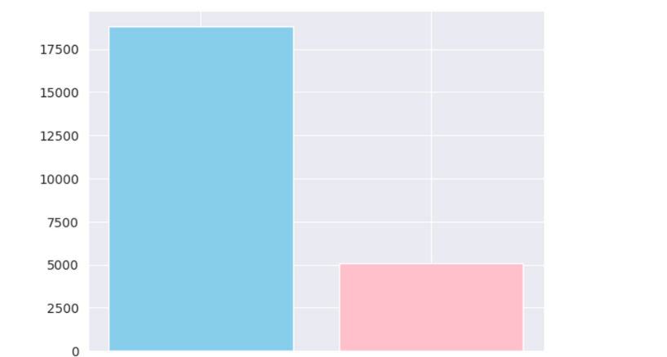
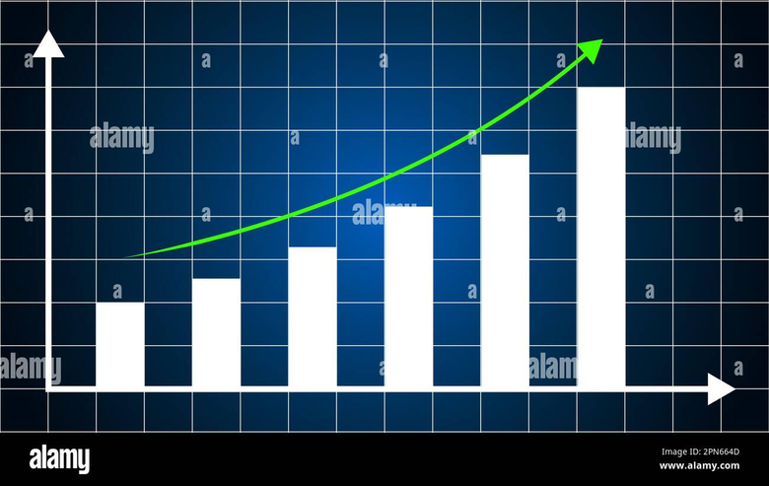
Data Analysis and Visualization
It helps in understanding complex data by presenting it visually, making patterns, trends, and outliers easier to detect and communicate.
Both are critical for making data-driven insights more accessible and actionable.

Slide 13

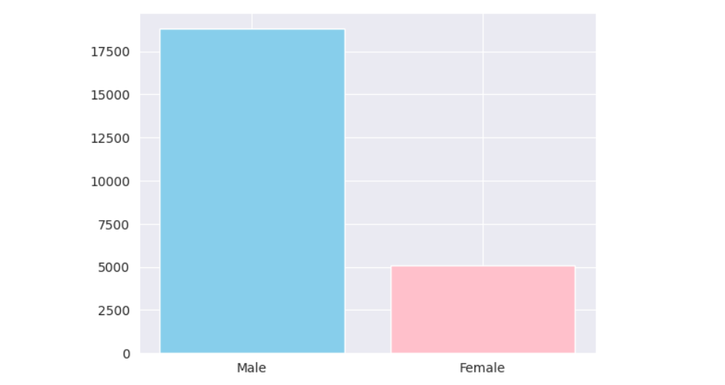
Sales for each Gender

Slide 14
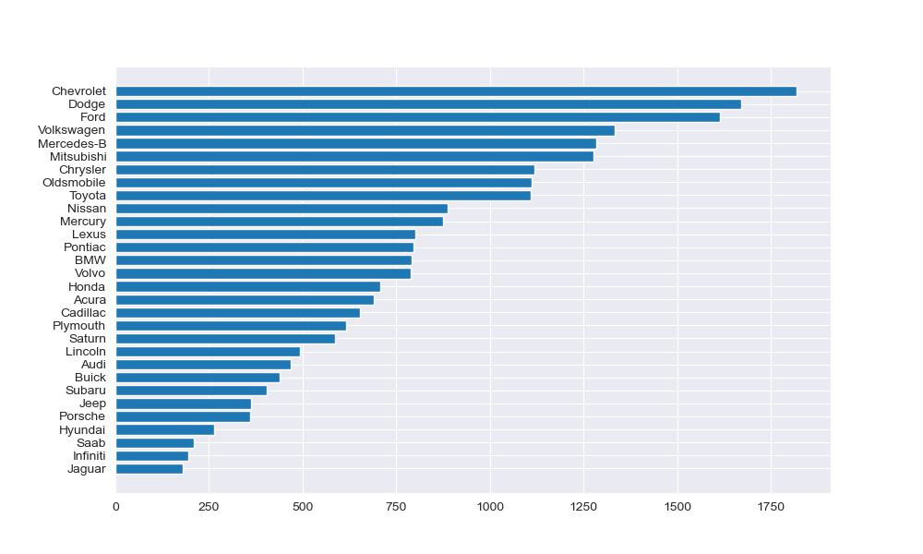
number of deals for each company

Slide 15
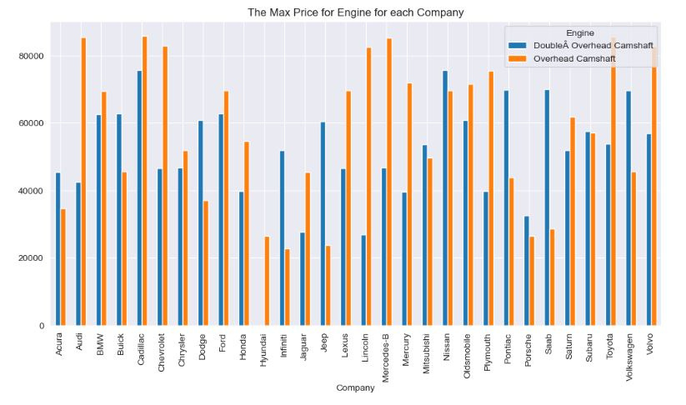
Max Price for Engine for each Company

Slide 16
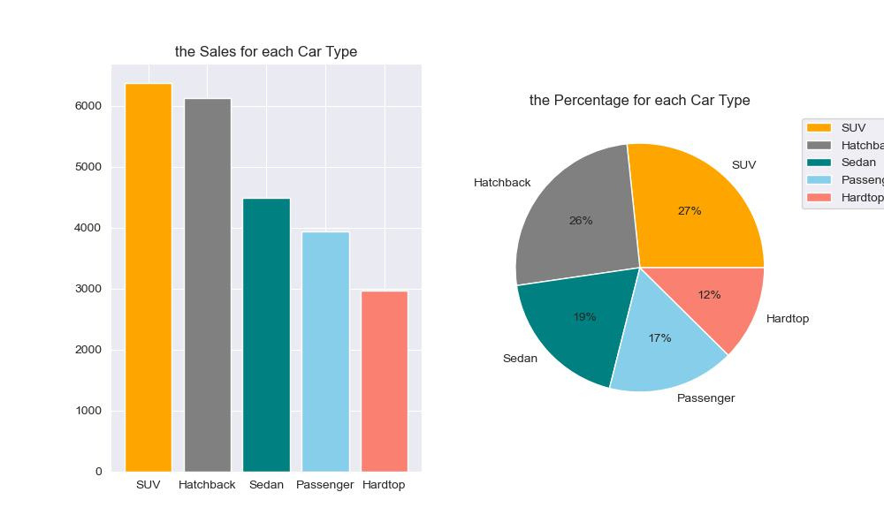
Percentage & Sales for each Car Type

Slide 17
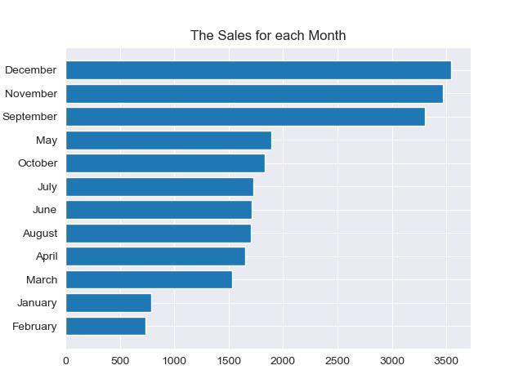
Sales for each Month

Slide 18
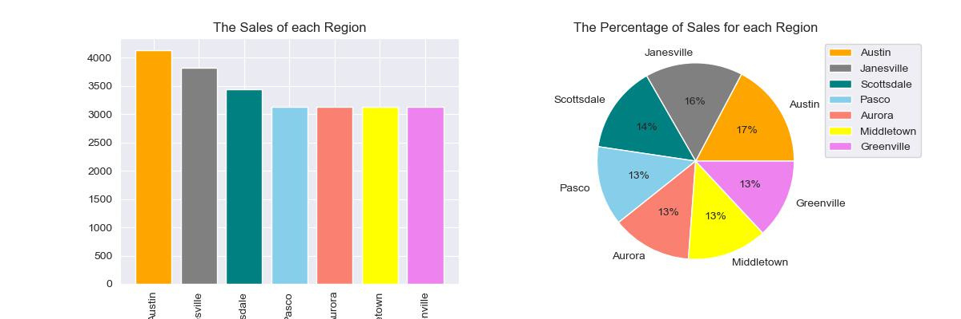
Sales & Percentage of each Region

Slide 19
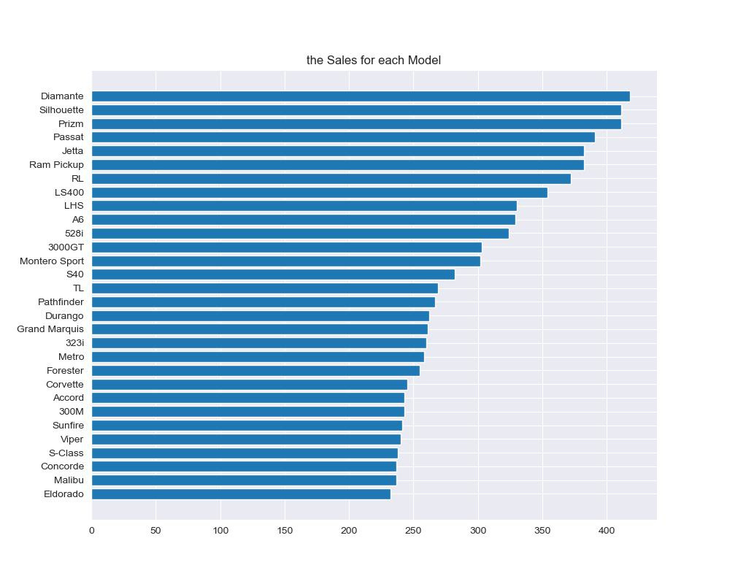
Sales for each model

Slide 20
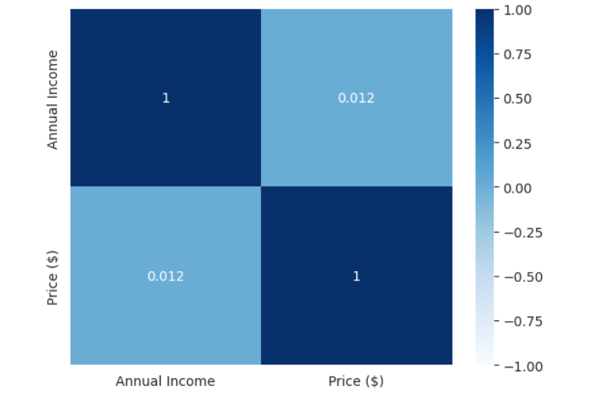
The Correlation of Annual Income & Price

Slide 21

Data Encoding :
CONVERT CATEGORICAL FEATURES INTO
NUMERICAL FORMAT USING TECHNIQUES LIKE
ONE-HOT ENCODING, LABEL ENCODING, OR
ORDINAL ENCODING, DEPENDING ON THE
NATURE OF THE CATEGORICAL DATA.
Ordinal Encoding :
Non ordinal Encoding :
ASSIGNS ORDERED NUMERICAL VALUES TO CATEGORIES WITH A MEANINGFUL RANKING
ASSIGNS A UNIQUE NUMERICAL VALUE TO EACH CATEGORY

Slide 22
Data Scaling:
IS THE PROCESS OF TRANSFORMING FEATURES TO A SPECIFIC RANGE OR DISTRIBUTION TO ENSURE THAT ALL VARIABLES CONTRIBUTE EQUALLY TO THE MODEL. THIS IS ESSENTIAL FOR ALGORITHMS SENSITIVE TO FEATURE MAGNITUDE, LIKE GRADIENT DESCENT-BASED MODELS
Min-Max Scaling:
Standardization :
Robust Scaling:
CENTERS DATA TO PRODUCEA DISTRIBUTION WITH MEAN 0 AND STANDARD DEVIATION 1.
SCALES DATA BASED ON THE INTERQUARTILE RANGE (IQR), MAKING IT ROBUST TO OUTLIERS.
RESCALES DATA TO A FIXED RANGE, TYPICALLY [0, 1]

Slide 23
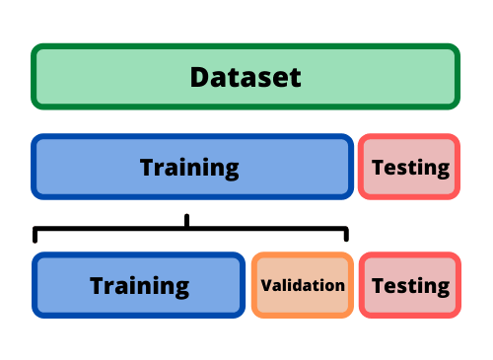
Train-test split
THE PROCESS OF DIVIDING A DATASET INTO TWO SUBSETS
SPLIT IS DONE IN AN 80-20 OR 70-30 RATIO
Test set :
Training set :
IS USED TO EVALUATE THE MODEL'S PERFORMANCE ON UNSEEN DATA
IS USED TO TRAIN THE MACHINE LEARNING MODEL

Slide 24

Model Development
first : Models Are Used :-
1- Linear Regression (LR)
2- Decision Tree (DT)
3- Random Forest (RF)
4- Support Vector Machine (SVM)
5- Gradient Boosting (GB)
6- Extreme Gradient Boosting (XGBoost)

Slide 25

1- Linear Regression
Linear Regression is a simple model that assumes a linear relationship between the input features and the target variable
Pros
cons
Simpilicity
Linearity
Efficient
Sensetive to Outliers
less prone to overfitting
Require Features Scalling

Slide 26

2- Decision Tree (DT)
is a non-linear model that splits the data into subsets based on feature thresholds, creating a tree-like structure.
Pros
cons
Non-linear modeling
Prone to overfitting
Easy to interpret
Instability
No need for feature scaling
Not always the most accurate

Slide 27

3- Random Forest
is an ensemble method that builds multiple decision trees and averages their predictions to improve accuracy and robustness.
Pros
cons
Handles non-linear relationships
Less interpretable
Reduces overfitting
Slower to train
Feature importance
May still overfit

Slide 28

4- Support Vector Machine
SVM aims to find a hyperplane that best separates data points in feature space. For regression (SVR), it tries to find a "tube" around the hyperplane that best fits the data..
Pros
cons
Effective in high-dimensional spaces:
Slow training
Requires careful tuning
Robust to outliers
Non_Linear modeling
Doesn't scale well

Slide 29


5- Gradient Boosting
is an ensemble technique that builds trees sequentially, where each new tree corrects the errors made by the previous trees.
Pros
cons
Handles non-linear relationships
Slow training
High accuracy
Sensitive to outliers
Feature importance
Prone to overfitting

Slide 30

6- XGBoost (Extreme Gradient Boosting)
XGBoost is an optimized version of gradient boosting that incorporates regularization to prevent overfitting and provides faster computation.
Pros
cons
High accuracy
Complex tuning
Handles non-linear relationships
Computationally expensive
Fast training
Sensitive to noisy data

Slide 31
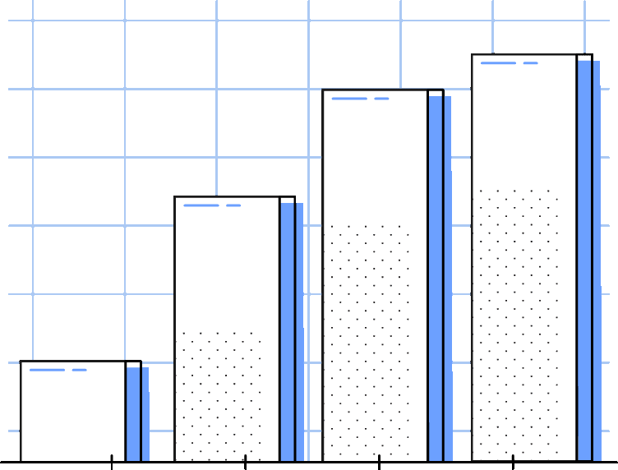
Expectations:
Best Performing Models
Lower Performing Models
Random Forest and Gradient Boosting:
Linear Regression and SVM:
are less likely to perform well due to their need for numeric data and difficulty in handling high-dimensionality resulting from one-hot encoding.
they handle categorical data efficiently, avoid overfitting, and model non-linear relationships well.

Slide 32
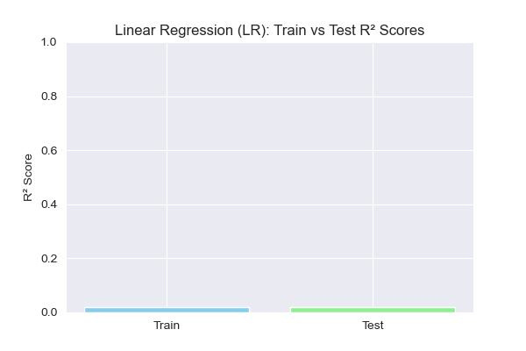
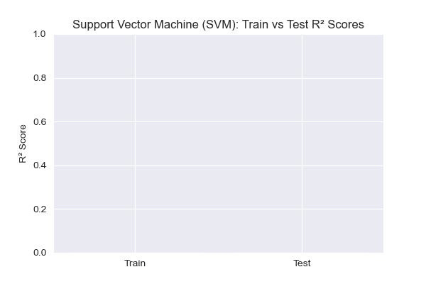
Price prediction
lower performing models :
Model: LinearRegression predicting
Mean Squared Error (MSE): 211509683.7877013
R² Score: 0.019302781824049542
Model: SVR predicting
Mean Squared Error (MSE): 240369167.29175463
R² Score: -0.114508657366733 77

Slide 33
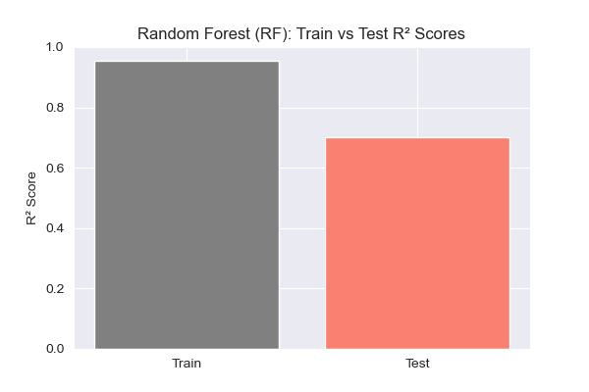
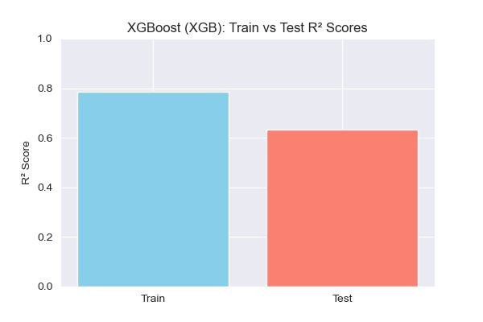
Price prediction
Best performing models :
Model: RandomForestRegressor predicting
Mean Squared Error (MSE): 64426126.92013921
R² Score: 0.7012783418850483
Model: xgboost predicting
Mean Squared Error (MSE): 78905006.99771266
R² Score: 0.6341447848766997

Slide 34
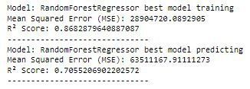
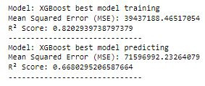
Model Tuning and Optimization
As a key step in improving model performance, we focused on tuning and optimizing the two best-performing models: Random Forest (RF) and XGBoost (XGB)

Slide 35
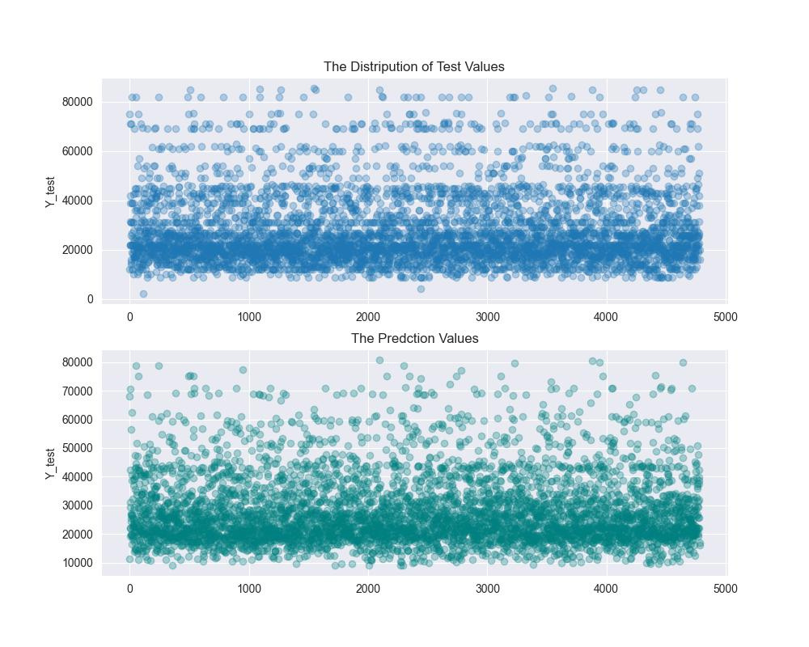
Final Prediction :

Slide 36



Github

Slide 37


Step 1: Set Up Git Locally
• For Windows: Download Git and install.
•Configure Git with your GitHub credentials
git config --global user.name "Your Name"
git config --global user.email "your-email@example.com"

Slide 38
Step 2: Create a GitHub Repository
Login to GitHub: Go to GitHub and log in to your account.
Create a New Repository:
Click the + icon in the top-right corner.
Choose New repository.
Name your repository, set it as public or private, and click Create repository.

Slide 39
Step 3: Initialize a Local Git Repository
Open a terminal and move to the folder where your project files are located
cd path/to/your/project
Initialize Git: Inside your project directory, initialize Git:
git init

Slide 40
Step 4: Connect to GitHub Repository
•Add Remote Repository: Connect your local repository to the GitHub repository:
git remote add origin https://github.com/username/repository-name.git
Step 5: Add Files
Stage All Files: To add all files in your project directory to be tracked by Git:
git add .
Commit your changes with a message describing what you're uploading:
git commit -m "Initial commit"

Slide 41
Step 6: Push Files to GitHub
Push Files to GitHub: Push your local changes to the remote GitHub repository:
git push -u origin master
•Step 7: Verify on GitHub
•Check GitHub: Visit your repository on GitHub to confirm that your files have been uploaded successfully.

Slide 42

DEPI
Streamlit

Slide 43
create an application for predicting car prices based on a set of input features.
We use our trained model to predict the price based on the input data.
Users can select features from dropdown lists and adjust their annual income for an accurate prediction.
Input car details such as : Gender ,Dealer Name, Company, Model, Color, Body Style, Dealer Region, Month, Weekday, day.
Display the predicted price based on inputs.
Main Features of the App

Slide 44
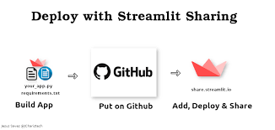

Slide 45

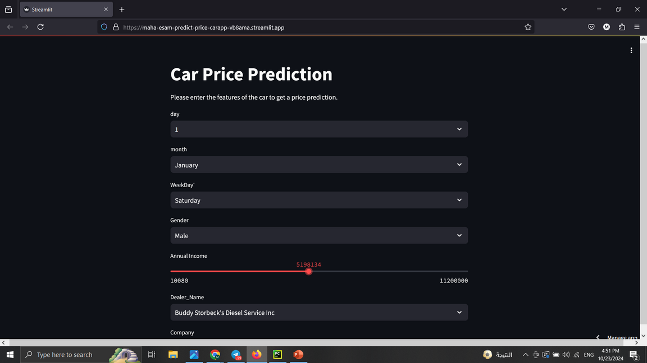
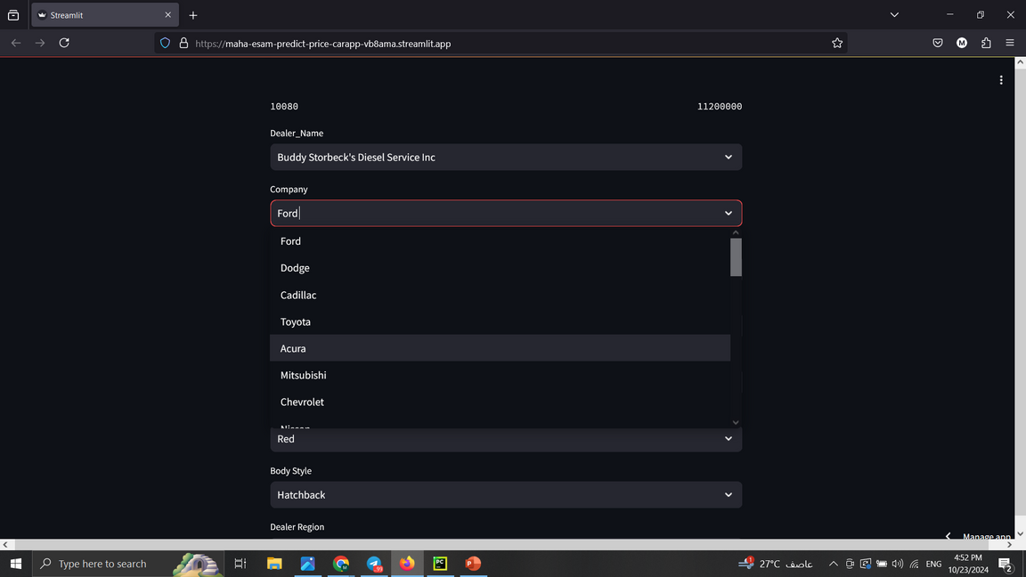
User Interface
the application interface is simple and user-friendly.
We have dropdown menus and buttons to facilitate data entry

Slide 46
Technologies Used
•We used Python as the backend for the application with libraries such as
Streamlit for building the interface
Pandas: for data processing.
Joblib: for loading the model.
These technologies help us provide a smooth and fast experience for users.

Slide 47



Linking GitHub with Streamlit
•the Streamlit Share service to host the application directly from GitHub. After uploading the application to a public repository,
we can log in to Streamlit Share and select the repository to run the application.
•his link facilitates collaboration among developers, allows for code reviews, and provides access to Streamlit applications for everyone

Slide 48
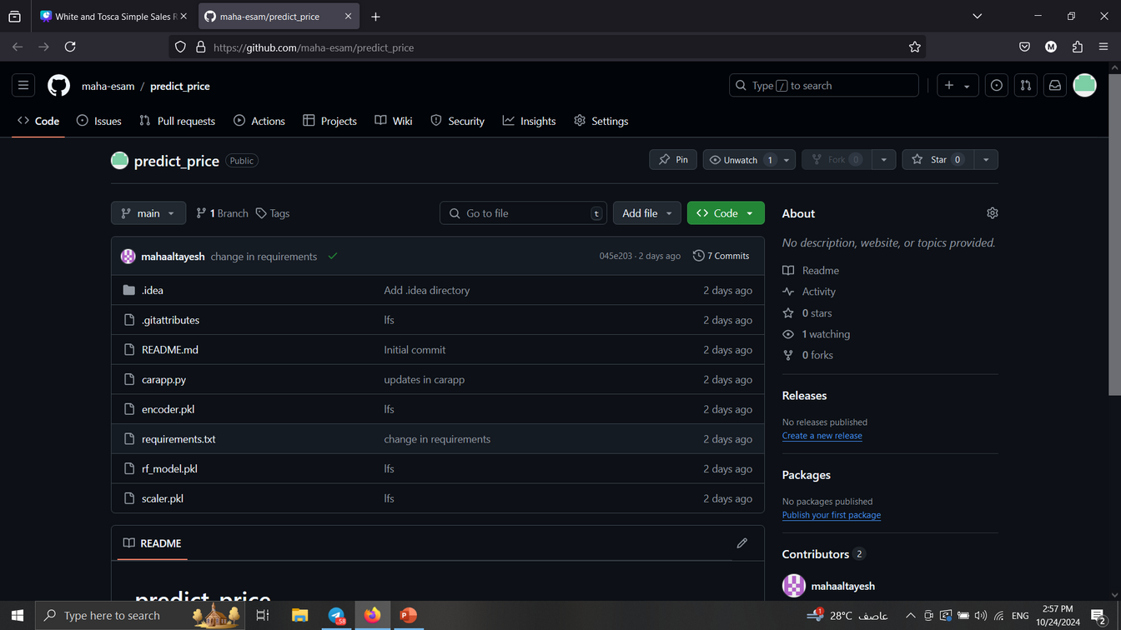
You can find the application code on GitHub at the following link
https://github.com/maha-esam/predict_price
carapp.py: The main application file
rf_model.pkl: The machine learning model.

Slide 49

facilitates sharing the project with others after deployment
•You can find the application code on GitHub at the following link or QR code
https://maha-esam-predict-price-carapp-vb8ama.streamlit.app/

Slide 50


DEPI
Thank You
24 oct, 2024

